Slide 1
Sentiment Analysis of Restaurant Reviews
By Prerna Kapoor

Slide 2



Overview
Nowadays, whenever a customer wants to buy a product online or book a hotel, the first thing they do is check out the reviews and ratings.
People share their thoughts by writing reviews based on their experiences.

Slide 3
Problem Statement
Reviews are an important part of any business because they build a business's reputation and influence consumer decisions.
A business can have thousands of reviews and ratings, and it would be very hard for them to read every review.
The current 5-star rating system is a simple way that provides little knowledge about customers' sentiments.
There needs to be an improved way to get more precise perceptions from massive amounts of text-based data.

Slide 4
Sentiment Analysis of Yelp Reviews
Text Input
Negation Handling
Stemming
Classification
Sentiment Class
Tokenization
Stopwords Filtering
Sentiment Analysis

Slide 5
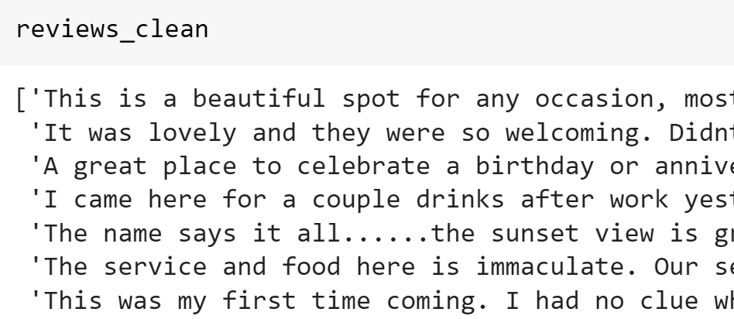
Data Extraction
Used Yelp API to access URLs for each location.
Used NYC Open Data to create list of 150+ restaurants in New York City.
Used python web scraping to scrape reviews from restaurant’s webpage.
Used Beautiful Soup to filter out HTML scripts.
End Result: 12000 unique reviews from 150+ restaurants.

Slide 6
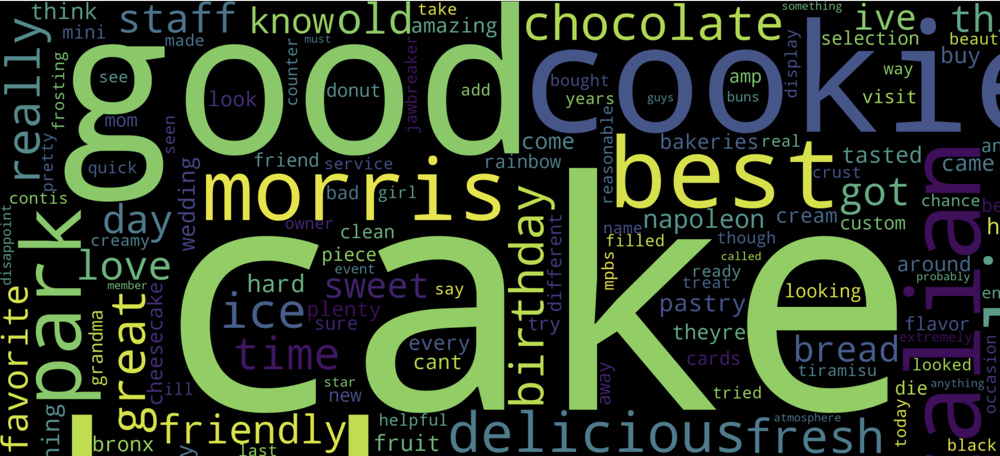
Word Cloud

Slide 7
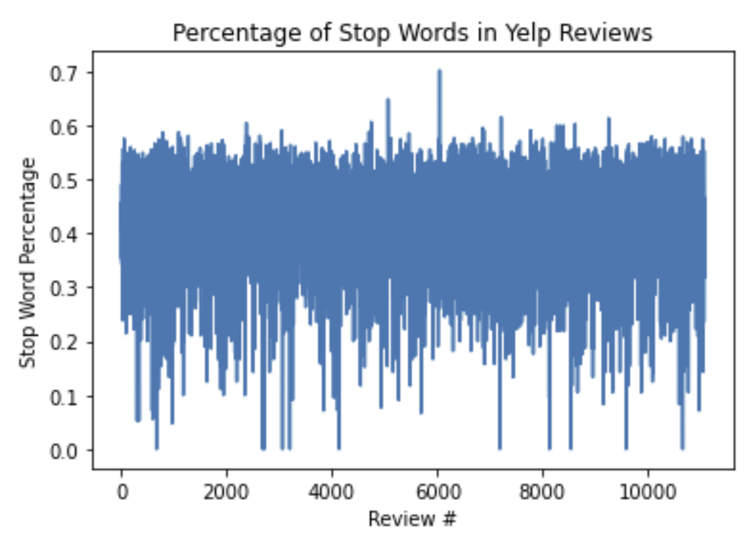
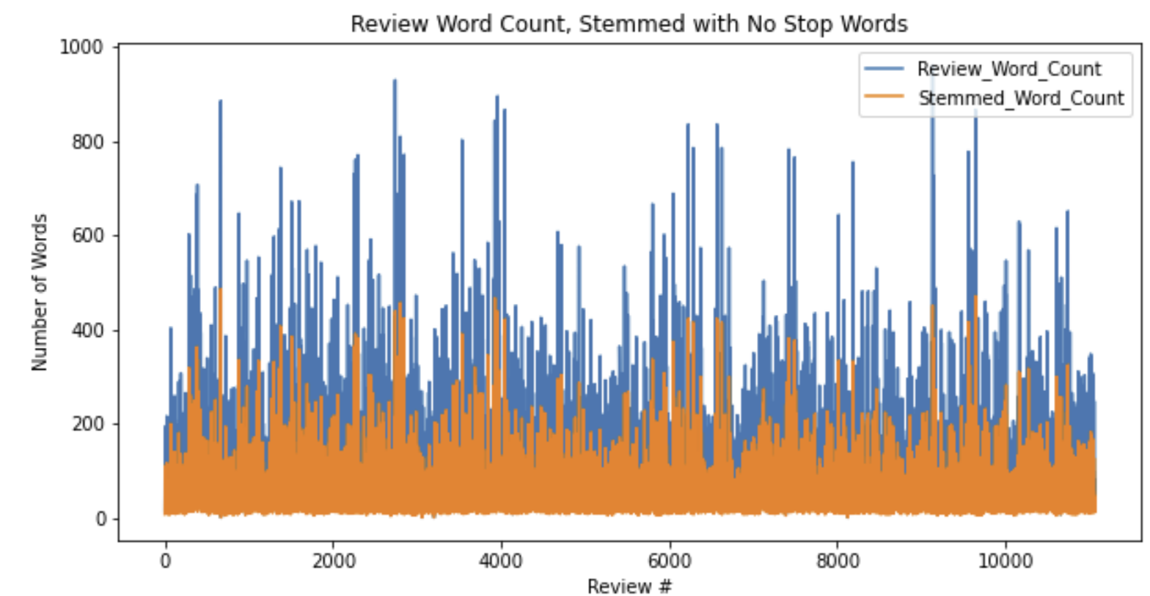
Stop Words: Yelp reviews are 40% stop words. Removing (to, the, in, etc.) saves memory & processing power. Stemming: process of reducing inflection in words to their root forms such as mapping a group of words to the same stem even if the stem itself is not a valid word.

Slide 8
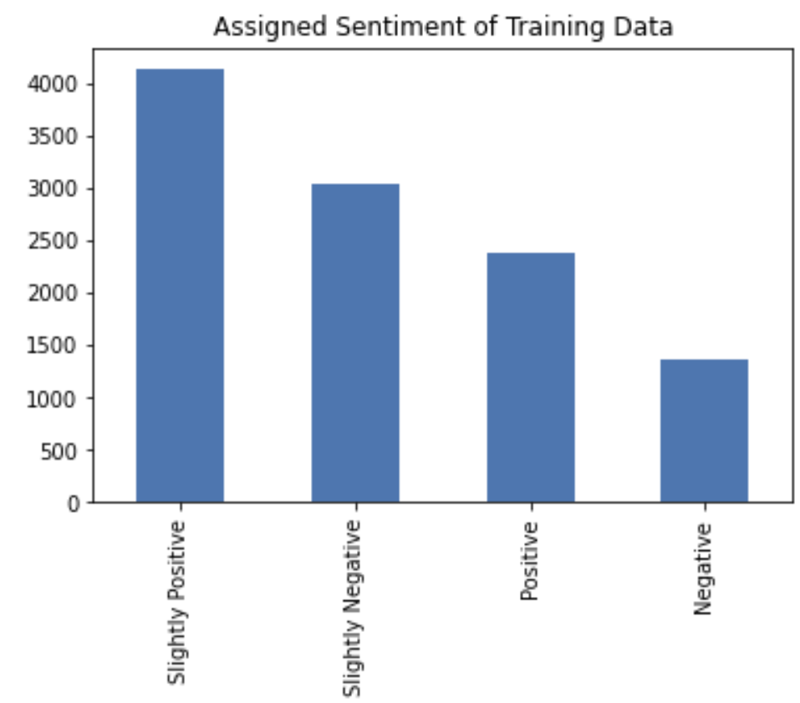
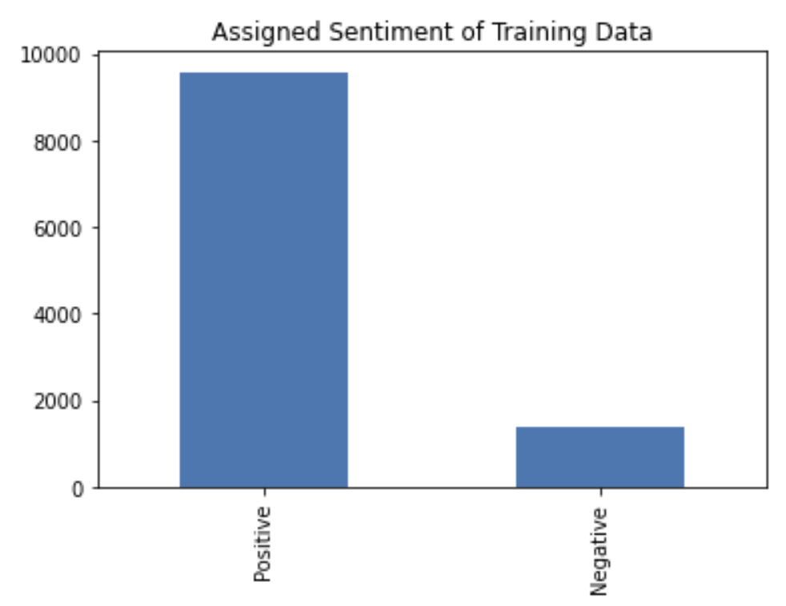
Classification
Assign sentiment using TextBlob’s Polarity Value
Polarity>0 Positive
Polarity<0 Negative
Polarity>=0.4 Positive
Polarity>=0.2 & Polarity<0.4 Slightly Positive
Polarity >0 & Polarity< 0.2 Slightly Negative
Polarity <0 Negative

Slide 9
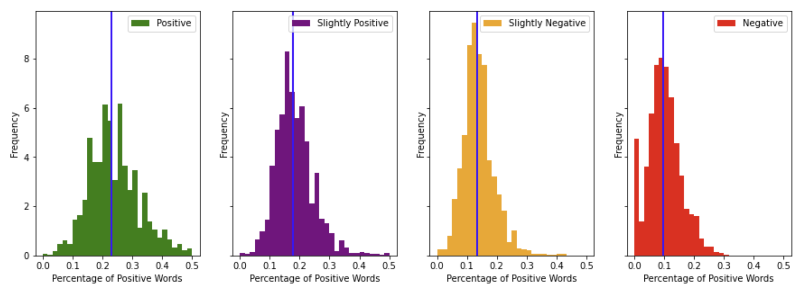
Feature Processing

Slide 10
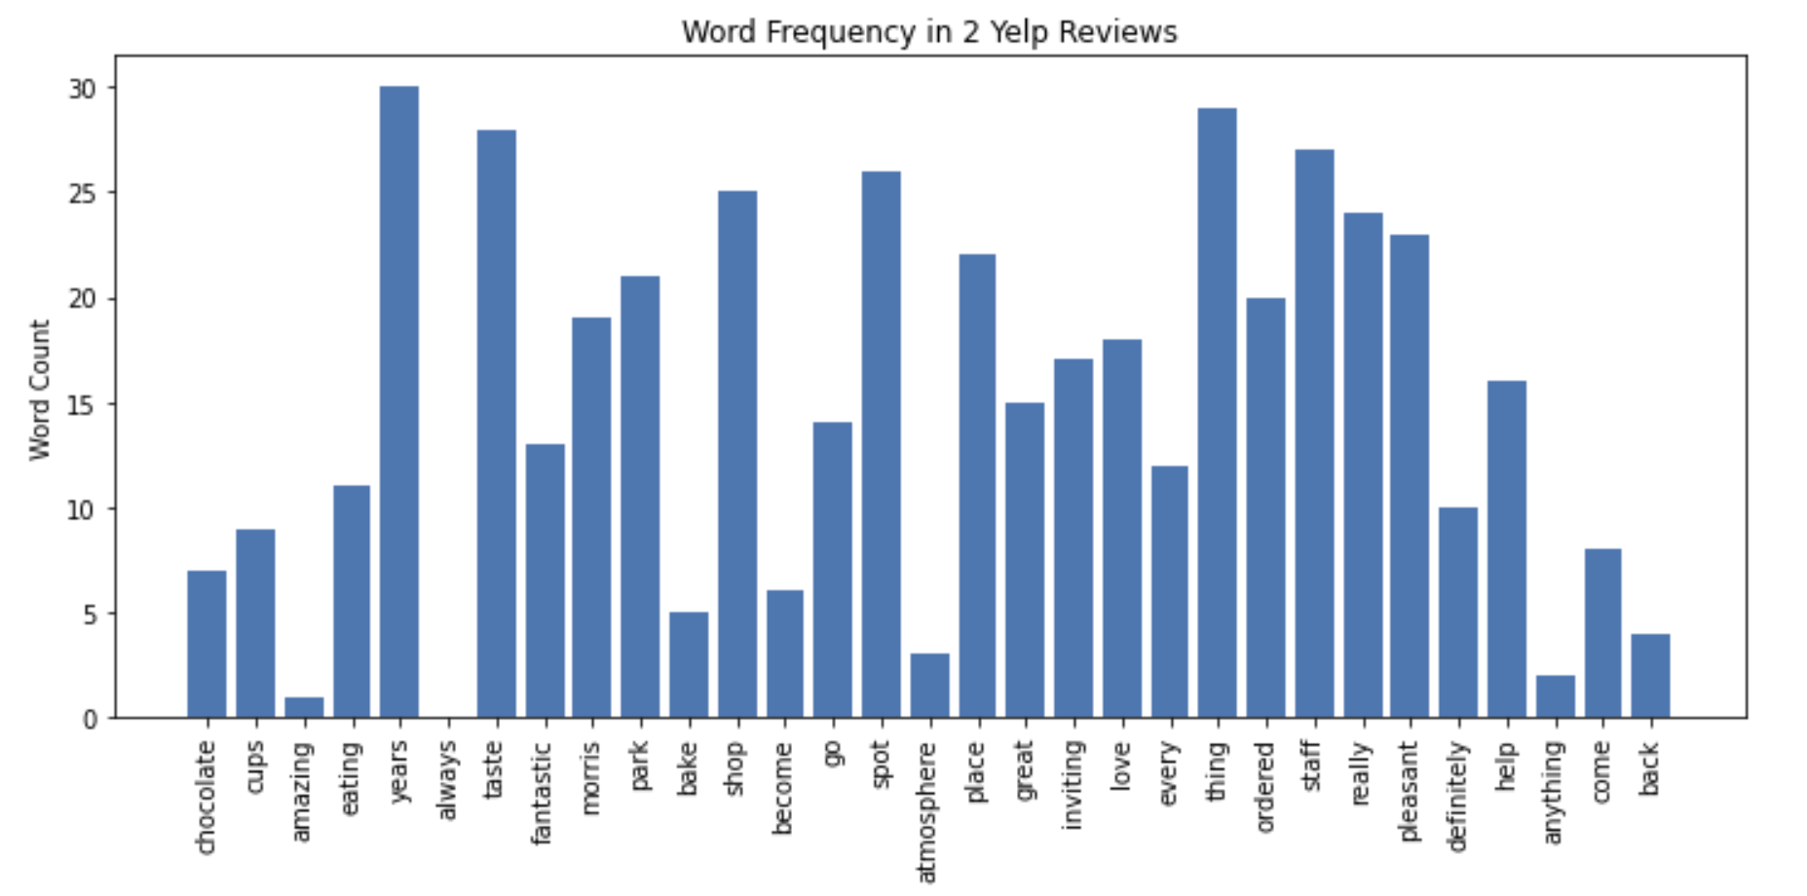
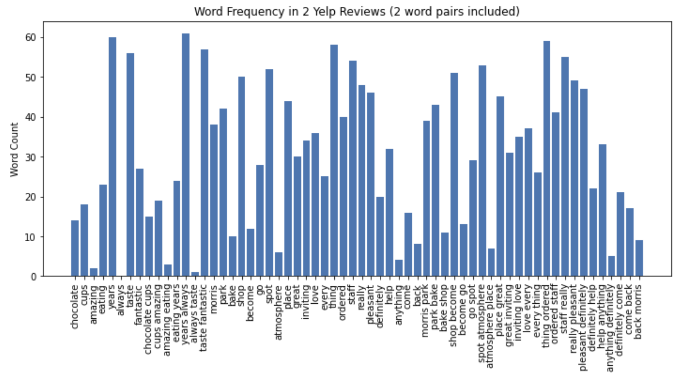
TFIDF: Term Frequency Inverse Document Frequency takes a count of words for all 12,000 reviews and assigns a score based on how often they appear in one review.
The Count Vectorizer uses the bag of words approach to convert text to word counts and, more importantly, a vector.

Slide 11
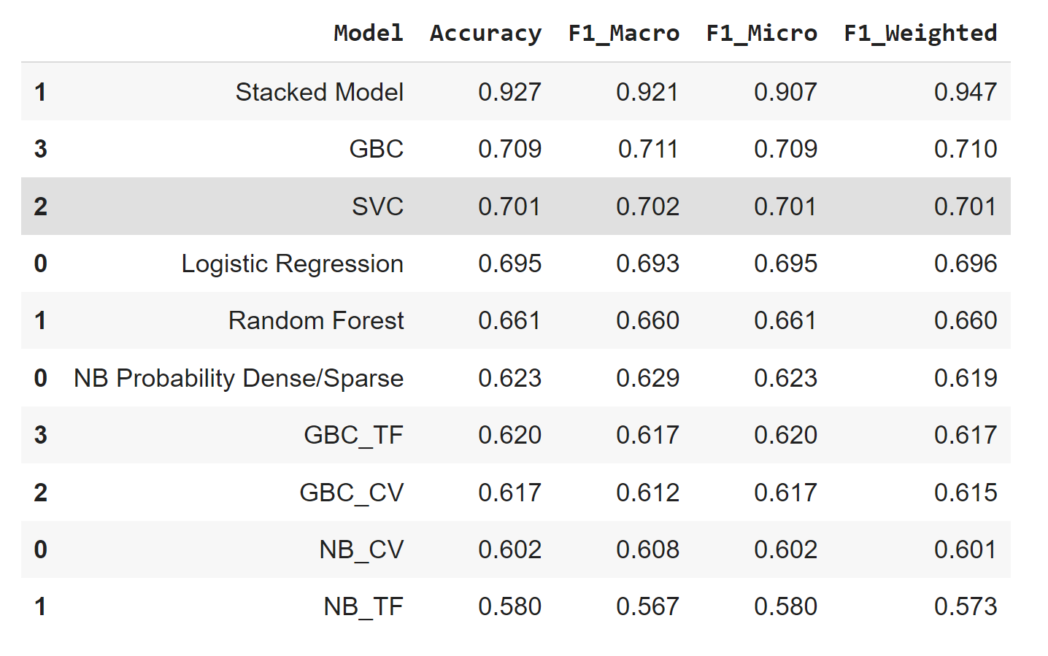
Model Selection
Part 1: ML With Extracted Features
- Logistic Regression
- Random Forest
- Support Vector Classification
- Gradient Boosted Classification
Part 2: ML With Bag of Words
- Naive Bayes with CountVectorizer
- Naive Bayes with TFIDF
- Gradient Boosted with CountVectorizer
- Gradient Boosted with TFIDF
Part 3: Ensemble Techniques
- Naive Bayes Probability Dense/Sparse
- Stacked Model
Part 4: Neural Network Model with 84% Accuracy

Slide 12
Stacked Model
Combination of two models:
Gradient Boosted Classification with TFIDF vectors and % of Positive Words as input
Naive Bayes with Dense/Sparse text matrix as input
Use Naive Bayes Model to Calculate Probability of sparse matrix being either Positive, Negative, Slightly Positive, or Slightly Negative
Added this as a feature to our Gradient Boosted Classification

Slide 13
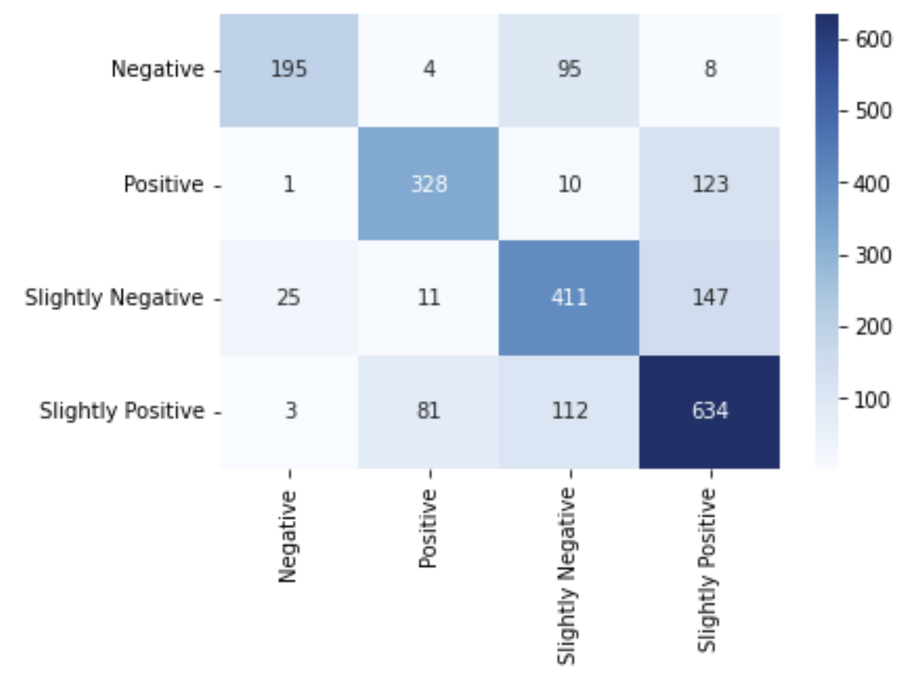
Confusion Matrix

Slide 14
Application
This model, when used can determine sentiment analysis for yelp review with up to 92% Accuracy.
It would be very valuable for business owners to know how people feel but also what is making them feel that way
Much more enlightening than the ‘5 star’ system

Slide 15
Conclusion
As a result, this allows the enterprise to make necessary and accurate adjustments to their business operations and customer experience by improving processes.
This data science product can be applied to businesses that have their businesses on yelp and uses customer review feedback, such as hotels, retail stores, restaurants, and medical practices.

Slide 16
Recommendations
The model’s accuracy will only improve over time as more data is tested.
This has major business implications and could be very useful for any service that receives mostly text-based reviews.
There is also room for growth when it comes to classification.

Slide 17
Thank You

